Slide 1


Rosetta Primary School
Calculation Policy
October 2015

Slide 2
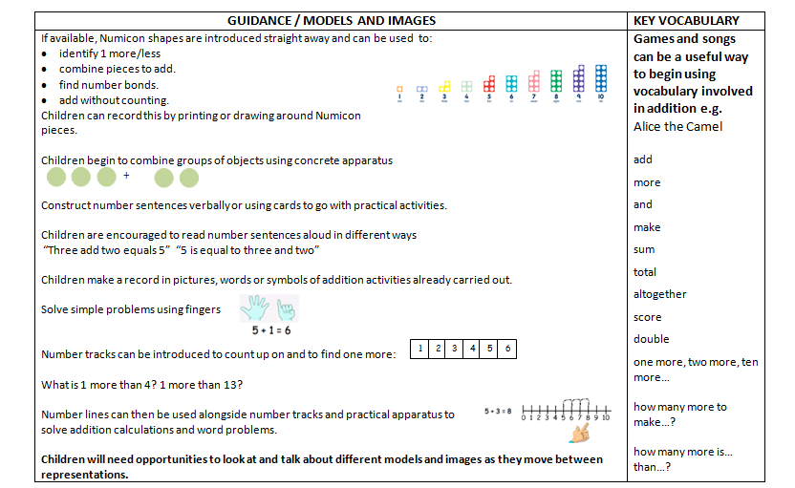
Reception Addition
Maths for young children should be meaningful. Where possible, concepts should be taught in the context of real life.

Slide 3
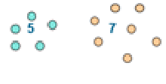
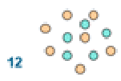
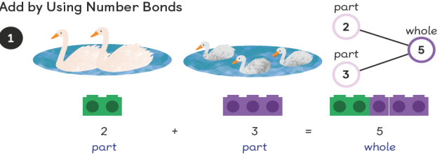

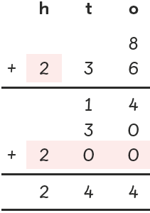

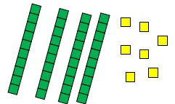
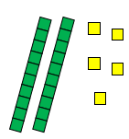
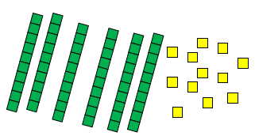
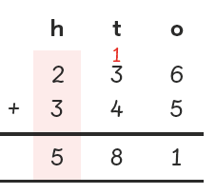
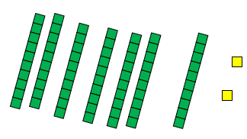
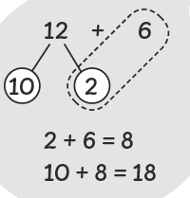
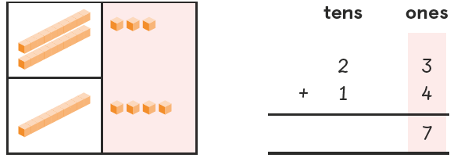
Year 1 Addition | Year 2 Addition | Year 3 Addition
Counting and Combining sets of Objects to 20 Combining two sets of objects e.g. Numicon, bundles of straws, Dienes apparatus, multi-link cubes, bead strings, ten frames, etc which will progress onto adding on to a set. Understanding of counting using knowledge of number bonds Understanding of counting on (supported by models and images). 7+ 4 If appropriate, progress from using number lines with every number shown to number lines with significant numbers shown. Partitioning to add Children should be able to separate 2 digit numbers to add the ones then add the tens. + = signs and missing numbers Children need to understand the concept of equality before using the ‘=’ sign. Calculations should be written either side of the equality sign so that the sign is not just interpreted as ‘the answer’. 2 = 1+ 1 2 + 3 = 4 + 1 | It is valuable to use a range of representations (also see Y1). Continue to use objects , number lines and ten frames to develop understanding of commutative law and of: Counting on in tens and ones 23 + 12 = 23 + 10 + 2 = 33 + 2 = 35 Partitioning and bridging through 10. The steps in addition often bridge through a multiple of 10 e.g. Children should be able to partition the 7 to relate adding the 2 and then the 5. 8 + 7 = 15 Adding 9 or 11 by adding 10 and adjusting by 1 e.g. Add 9 by adding 10 and adjusting by 1 35 + 9 = 44 Towards a Written Method Partitioning in different ways and recombine to 100 47+25 47 25 60 + 12 Leading to exchanging: 72 Standard column method: Missing number problems e.g 14 + 5 = 10 + 32 + + = 100 35 = 1 + + 5 | Partition into tens and ones Partition both numbers and recombine. Count on by partitioning the second number only e.g. 247 + 125 = 247 + 100 + 20+ 5 = 347 + 20 + 5 = 367 + 5 = 372 Children need to be secure adding multiples of 100 and 10 to any three-digit number including those that are not multiples of 10. Towards a Written Method to 1000 Standard column addition can be modelled with place value counters, objects and pictorial representations. Leading to children understanding the renaming between tens and ones (carrying/exchanging). Introduce the Bar Method (See Appendix 1). Missing number problems using a range of equations as in Year 1 and 2 but with appropriate, larger numbers.

Slide 4
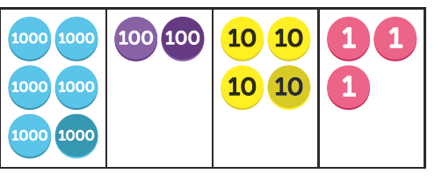
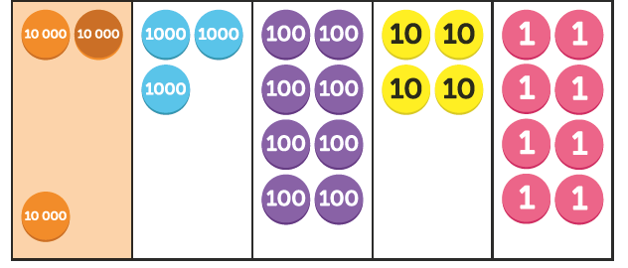
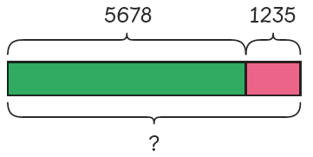
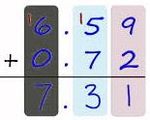
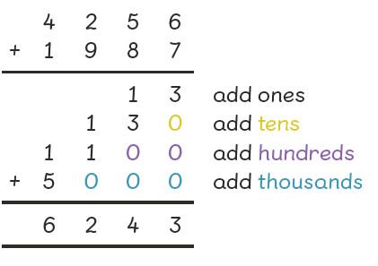
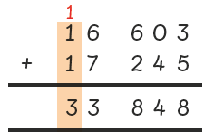
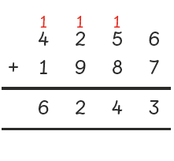
Year 4 Addition | Year 5 Addition | Year 6 Addition
Mental methods (within 10,000) should continue to develop, supported by a range of models and images, including the number line. Written methods (progressing to 4-digits & 1dp) Continue to model column addition modelled with place value counters, objects, pictorial representations and the Bar Method (See Appendix 1) Extend to numbers with at least four digits, including renaming between various columns (carrying). Select and use different methods to solve word problems, involving two step problems in context. | Mental methods (within 1,000,000) should continue to develop, supported by a range of models and images, including place value counters. Children should practise with increasingly large numbers to aid fluency e.g. 12462 + 2300 = 14762 Written methods (progressing to more than 4-digits & 2dp) As in Year 4, continue to explore column addition modelled with place value counters, objects, pictorial representations and the Bar Method (See Appendix 1) Children will move on to the formal columnar method for whole numbers and decimal numbers as an efficient written method. Select and use different methods to solve word problems, involving two step problems in context. | Mental methods should continue to develop, supported by a range of models and images, including the number line. Written methods As in Year 5, progressing to larger numbers, aiming for both conceptual understanding and procedural fluency with columnar method to be secured. Continue to model with place value counters, objects, pictorial representations and the Bar Method (See Appendix 1) Continue calculating with decimals, including those with different numbers of decimal places, and develop procedural fluency with renaming (carrying) to be secured. Problem Solving Teachers should ensure that pupils have the opportunity to apply their knowledge in a variety of contexts and problems (exploring cross curricular links) to deepen their understanding. .

Slide 5
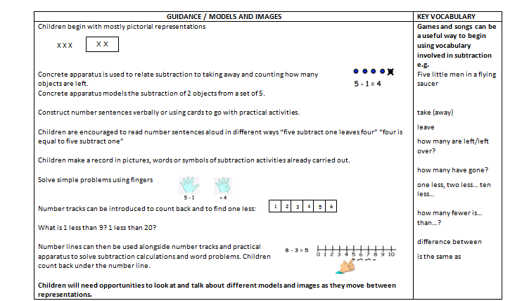
Reception Subtraction
Maths for young children should be meaningful. Where possible, concepts should be taught in the context of real life.

Slide 6

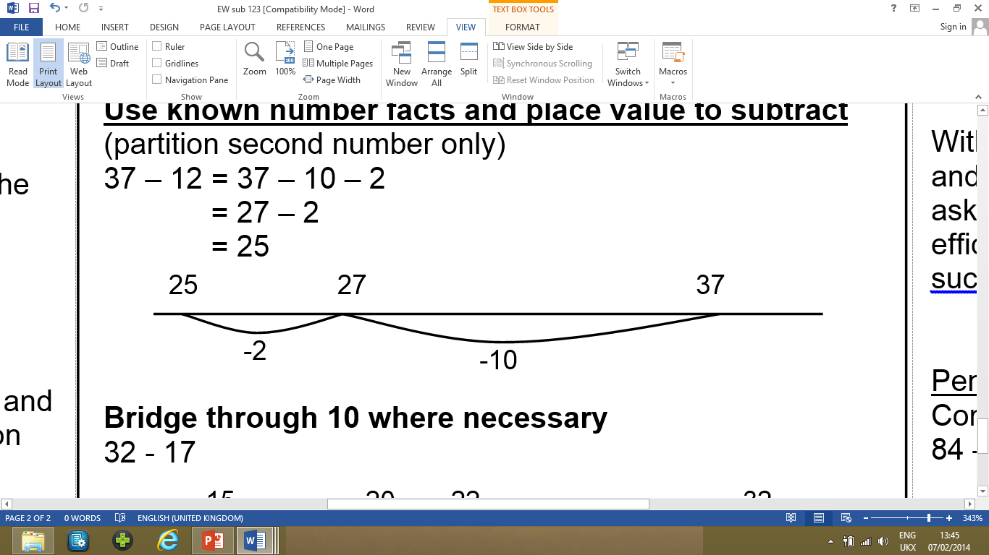
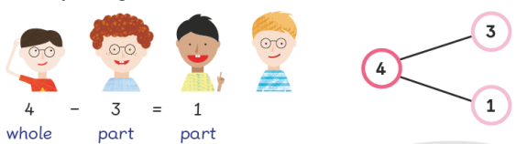
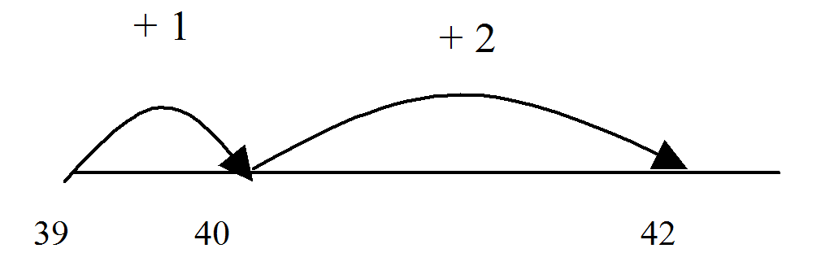
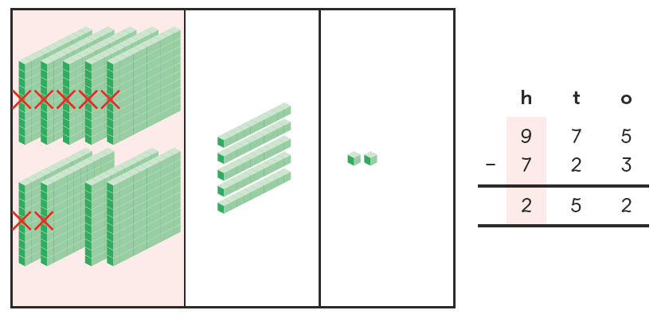
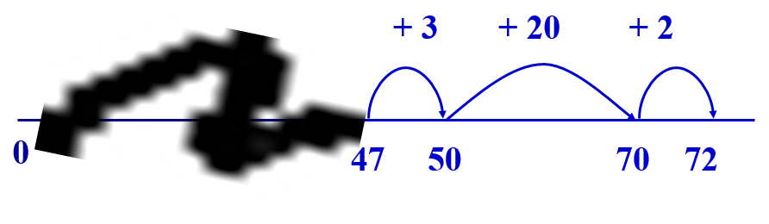
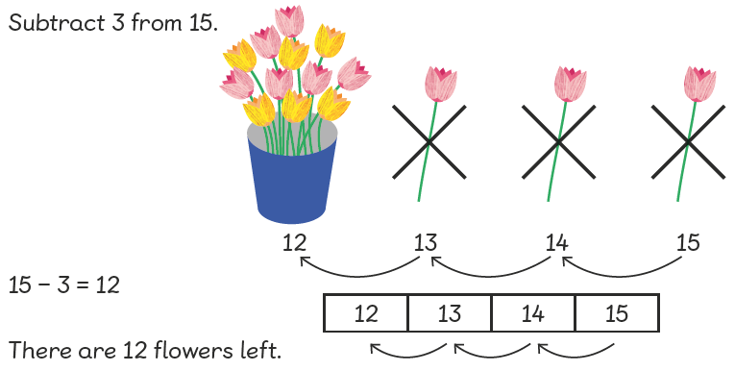
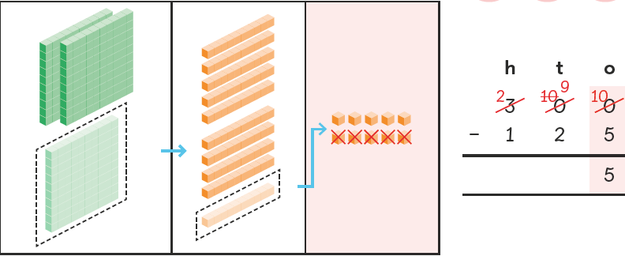
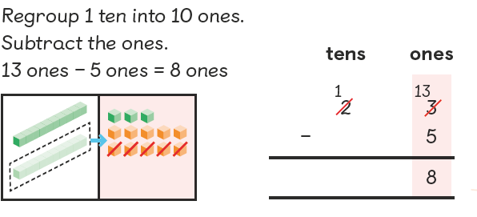
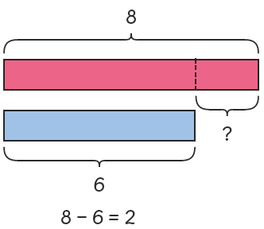
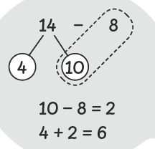
Year 1 Subtraction | Year 2 Subtraction | Year 3 Subtraction
Understand subtraction as crossing out (take-away) (within 20): 7 – 2 = 5 Using knowledge of number bonds to subtract (within 20): Understand subtraction as counting back (within 20): Use concrete objects and pictorial representations. Progress from using number lines with every number shown to number lines with significant numbers shown. Partitioning to subtract Children should be able to separate 2 digit numbers to subtract from the tens then add the leftover ones. Missing number problems e.g. 7 = □ - 9; 20 - □ = 9; 15 – 9 = □; □ - □ = 11; 16 – 0 = □ | It is valuable to use a range of representations (also see Y1). Continue to use dienes, number lines, ten frames and objects to model take-away and difference. E.g. The link between the two may be supported by an image like this, with 47 being taken away from 72, leaving the difference, which is 25. Towards written methods within 100 Record addition and subtraction in columns, the numbers may be represented with objects and pictorial representations. E.g. 23 – 5. Progress to renaming (borrowing). Missing number problems, including use of inverse relationships e.g. 52 – 8 = □; □ – 20 = 25; 22 = □ – 21; 6 + □ + 3 = 11 | Mental methods should continue to develop, supported by a range of models and images, including the number line Children should make choices about which strategy to use, depending on the numbers involved. Written methods (progressing to 3-digits) Continue to model column subtraction with no renaming (borrowing/decomposition), modelled with objects such as place value counters, Numicon and Dienes. This will lead to renaming (borrowing), modelled using place value counters or Dienes. Introduce the Bar Method (See Appendix 1). Missing number problems, including use of inverse relationships e.g. □ = 43 – 27; 145 – □ = 138; 274 – 30 = □; 245 – □ = 195; 532 – 200 = □; 364 – 153 = □

Slide 7
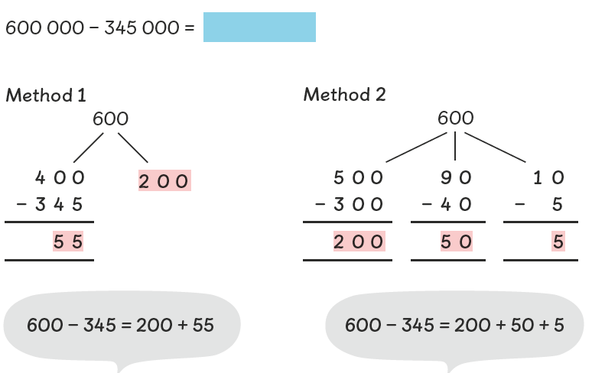
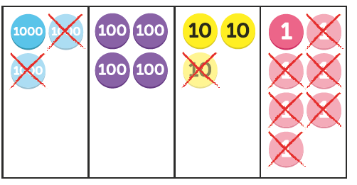
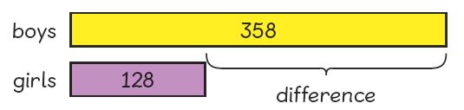
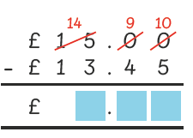
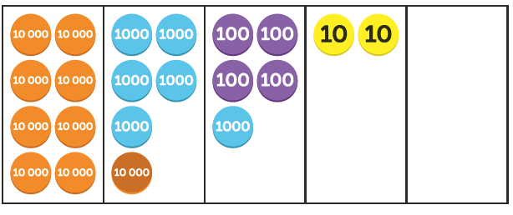
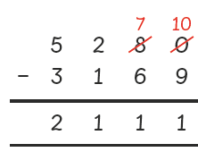
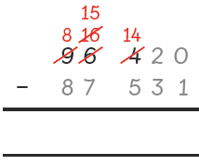
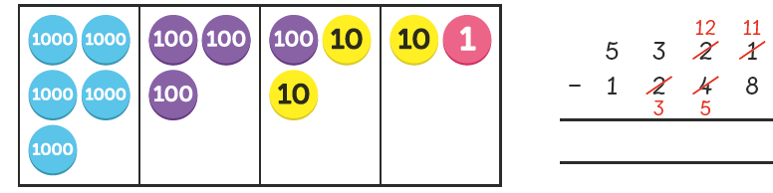
Year 4 Subtraction | Year 5 Subtraction | Year 6 Subtraction
Mental methods (within 10,000) should continue to develop, supported by a range of models and images, including partitioning. Written methods (progressing to 4-digits & 1 dp) Continue to use column subtraction modelled with place value counters, objects, pictorial representations and the Bar Method (See Appendix 1) Extend to numbers with at least four digits, including renaming between various columns (borrowing). Use place value counters to explore compensation method: Select and use different methods to solve word problems, involving two step problems in context. Missing number/digit problems, including use of inverse relationships: 200 – 90 – 80 = □; 225 - □ = 150; □ – 25 = 67; □ - 2000 = 900 | Mental methods (within 1 000 000) should continue to develop, supported by a range of models and images, including partitioning. Written methods (progressing to more than 4-digits) As in Year 4, continue to use place value counters to support understanding of decomposition (renaming/borrowing) in formal written method. E.g. 96 420 – 87 531 = Continue to select and use different methods to solve word problems, involving two step problems in context. Missing number/digit problems: 6.45 = 6 + 0.4 + □; 119 - □ = 86; 1 000 000 - □ = 999 000; 600 000 + □ + 1000 = 671 000; 12 462 – 2 300 = □ | Mental methods should continue to develop, supported by a range of models and images, Written methods As in Year 5, progressing to larger numbers, aiming for both conceptual understanding and procedural fluency with columnar method to be secured. Continue to model with place value counters, objects, pictorial representations and the Bar Method (See Appendix 1) Continue calculating with decimals, including those with different numbers of decimal places, and develop procedural fluency with decomposition (borrowing) to be secured. Problem Solving Teachers should ensure that pupils have the opportunity to apply their knowledge in a variety of contexts and problems (exploring cross curricular links) to deepen their understanding.

Slide 8
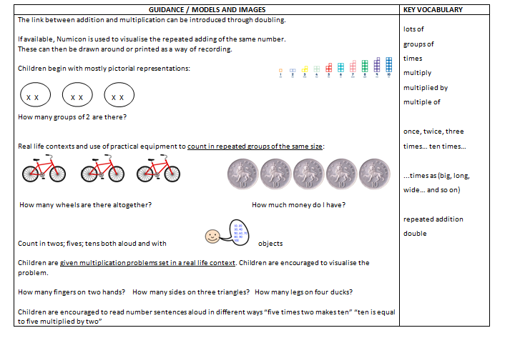
Reception Multiplication
Maths for young children should be meaningful. Where possible, concepts should be taught in the context of real life.

Slide 9

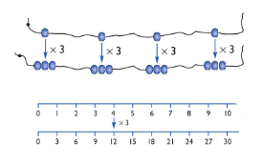
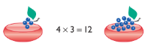
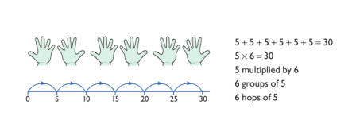
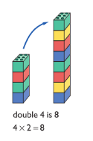
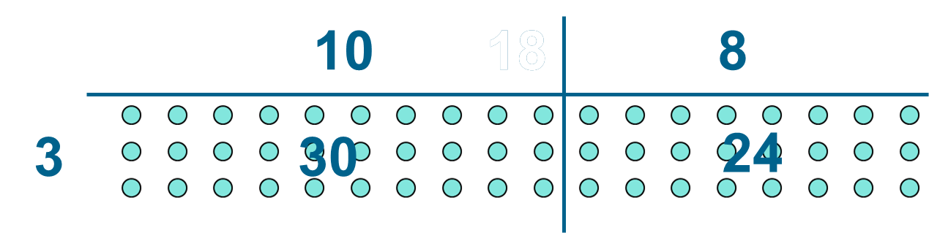
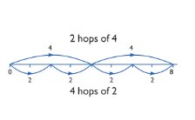
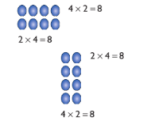
Year 1 Multiplication | Year 2 Multiplication | Year 3 Multiplication
Understand multiplication is related to doubling and combing groups of the same size (repeated addition) for 2, 5, 10. Washing line, and other practical resources for counting. Concrete objects: Dienes, Numicon, bundles of straws, bead strings. Problem solving with concrete objects (including money and measures) Use arrays to begin to understand multiplication can be done in any order (commutative) | Expressing multiplication as a number sentence using x and explore commutative law of multiplication Recall and use multiplication facts for the 2, 5 and 10 multiplication tables Develop understanding of solving multiplication problems using arrays, objects, pictorial representations and number lines (see Year 1). Begin to develop understanding of multiplication as scaling (3 times bigger/taller) Doubling numbers up to 10 + 10 Link with understanding scaling Using known doubles to work out double 2digit numbers (double 15 = double 10 + double 5) Towards written methods Use arrays and jottings to develop an understanding of doubling two digit numbers. 16 10 6 x2 x2 20 12 Use understanding of the inverse and practical resources to solve missing number problems. 7 x 2 = = 2 x 7 7 x = 14 14 = x 7 x 2 = 14 14 = 2 x | Mental methods Doubling 2 digit numbers using partitioning Demonstrating multiplication on a number line – jumping in larger groups of amounts 13 x 4 = 10 groups of 4 then 3 groups of 4 Recall and use multiplication facts for the 3, 4 and 8 multiplication tables Written methods (progressing to 3digit x 1digit) Developing written methods using understanding of visual images to group and create equal groups of objects and pictures Give children opportunities for children to explore this and deepen understanding of commutative law of multiplication using Numicon, Dienes , place value counters and pictorial representations. Develop understanding of solving multiplication problems using arrays, objects, pictorial representations and number lines (see Year 1).

Slide 10
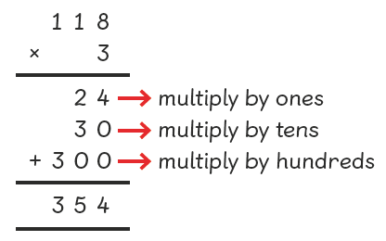
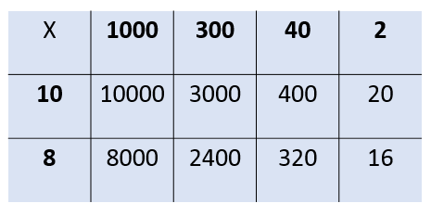
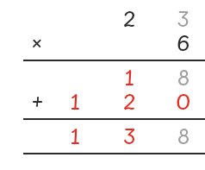
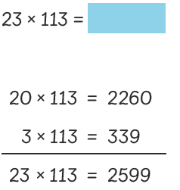




Year 4 Multiplication | Year 5 Multiplication | Year 6 Multiplication
Mental methods Counting in multiples of 6, 7, 9, 25 and 1000, and steps of 1/100. Recall and use multiplication facts for the 6, 7, 9, 11 and 12 multiplication tables Use known facts to multiply by multiples of 10 Written methods (progressing to 3digit x 2digit, including 1dp) Children to embed and deepen their understanding to multiply up to 2d x 2d progressing to 3d x 2d and decimals to 1dp. Ensure this is still linked back to their understanding of arrays and supported using place value counters. Leading to short written method including renaming (carrying): Children to use their knowledge of multiplication tables and inverse, supported by pictorial representations and the Bar Method (See Appendix 1), to help solve word problems in context. | Mental methods X whole numbers and decimals by 10, 100, 1000 using knowledge of place value to move digits Use practical resources and jottings to explore equivalent statements (e.g. 4 x 35 = 2 x 2 x 35) Recall of prime numbers up to 19 and identify prime numbers up to 100 (with reasoning) Identify multiples and factor pairs for numbers Written methods (progressing to 4d x 2d) Children to continue to explore long and short methods: As in Year 4, children to use their knowledge of multiplication tables and inverse, supported by pictorial representations and the Bar Method (See Appendix 1), to help solve word problems in context. Introduce grid method to multiply 2 digit numbers by 2 digit numbers e.g. 39 x 51 = | Mental methods Identifying common factors and multiples of given numbers and prime numbers X 2d and 3d numbers by 1d mentally or using jottings Perform mental calculations including mixed operations and large numbers Written methods Continue to refine and deepen understanding of written methods including grid method, expanded column and fluency for using column multiplication supported by jottings and the Bar Method (See Appendix 1) Grid method: Expanded method: Column method: Problem Solving Teachers should ensure that pupils have the opportunity to apply their knowledge in a variety of contexts and problems (exploring cross curricular links) to deepen their understanding.

Slide 11

Reception Division and fractions
Maths for young children should be meaningful. Where possible, concepts should be taught in the context of real life.

Slide 12








Year 1 Division | Year 2 Division | Year 3 Division
Children must have secure counting skills- being able to confidently count in 2s, 5s and 10s. Children should be given opportunities to reason about what they notice in number patterns. Group AND share small quantities to 10- understanding the difference between the two concepts. Sharing Develops importance of one-to-one correspondence. Children should be taught to share using concrete apparatus. Grouping Children should apply their counting skills to develop some understanding of grouping. How many groups of 2 in 6? Arrays as a pictorial representation can be used for division. 15 ÷ 3 = 5 There are 5 groups of 3. 15 ÷ 5 = 3 There are 3 groups of 5. Children should be able to find ½ of shapes, objects, numbers and quantities. | Know and understand sharing and grouping- introducing children to the ÷ sign. Recall and use division facts for the 2, 5 and 10 multiplication tables Children should continue to use grouping and sharing for division (dividends below 20) using practical apparatus, arrays and pictorial representations. Progress to Grouping using a numberline Group from zero in jumps of the divisor to find out ‘how many groups of 3 are there in 15?’. 15 ÷ 3 = 5 Continue work on arrays. Support children to understand how multiplication and division are inverse. Look at an array – what do you see? Remainders can be introduced. | Recall and use division facts for the 3, 4 and 8 multiplication tables Children should continue to use grouping and sharing for division using practical apparatus, arrays and pictorial representations. Place value counters, arrays and number lines can be used to support children apply their knowledge of grouping. Children need to be able to partition the dividend in different ways. 48 ÷ 4 = 12 +40 + 8 10 groups 2 groups ÷ = signs and missing numbers Continue using a range of equations as in year 2 but with appropriate numbers.

Slide 13





Year 4 Division | Year 5 Division | Year 6 Division
Recall division facts for the multiplication tables up to 12 x 12 Sharing, Grouping, Repeated Subtraction and Inverse Children will continue to explore division as sharing , grouping, repeated subtraction and inverse until they have a secure understanding. Continue to use pictorial representations and Bar Method (See Appendix 1) to solve word problems in context. Children should progress in their use of written division calculations: Using tables facts with which they are fluent Experiencing a logical progression in the numbers they use, for example: Dividend just over 10x the divisor, e.g. 84 ÷ 7 Dividend just over 10x the divisor when the divisor is a teen number, e.g. 173 ÷ 15 (learning sensible strategies for calculations such as 102 ÷ 17) Dividend over 100x the divisor, e.g. 840 ÷ 7 Dividend over 20x the divisor, e.g. 168 ÷ 7 All of the above stages should include calculations with remainders as well as without. Remainders should be interpreted according to the context. (i.e. rounded up or down to relate to the answer to the problem) |  | Sharing, Grouping, Repeated Subtraction and Inverse Children will continue to explore division as sharing , grouping, repeated subtraction and inverse and to represent problems using the Bar Method (See Appendix 1) if appropriate. Quotients (results of division) should be interpreted appropriately for the context as a whole number, remainders, decimal or fraction. Formal Written Methods – long and short division Continue to use partitioning, number bonds and place value counters to support the efficient use of long and short division methods including expressing remainder as a fraction or decimal Problem Solving Teachers should ensure that pupils have the opportunity to apply their knowledge in a variety of contexts and problems (exploring cross curricular links) to deepen their understanding.
Formal Written Methods Children to use partitioning to divide 2 and 3 digit numbers e.g 68 ÷ 2 = 34 Introduce Bus Stop Method: | Formal Written Methods Continue to use partitioning, number bonds and place value counters to support the efficient use of a formal long division method Children begin to practically develop their understanding of how to express the remainder as a decimal or a fraction. Ensure practical understanding allows children to work through this (e.g. What could I do with this remaining 1? How could I share this between 6 as well?)
0

